Slide 1
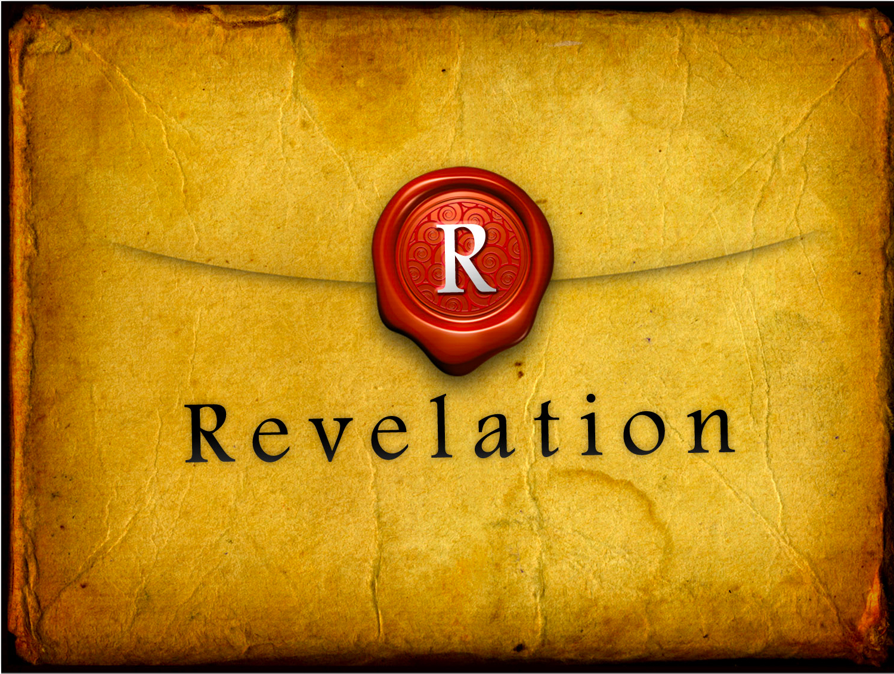
Revelation
Book Introduction (Part 1)

Slide 2
Breakdown of the Book of Revelation
Introduction (1:1-3:22)
Prologue (1:1-8)
Commissioning of John:
Vision of the Son of Man (1:9-20)

Slide 3
Breakdown of the Book of Revelation
Introduction continued (1:1-3:22)
Letters of Preparation to the Seven Churches (2:1-3:22)
To the Angel of Ephesus (2:1-7)
To the Angel of Smyrna (2:8-11)
To the Angel of Pergamum (2:12-17)
To the Angel of Thyatira (2:18-29)
To the Angel of Sardis (3:1-6)
To the Angel of Philadelphia (3:7-13)
To the Angel of Laodicea (3:14-22)

Slide 4
Breakdown of the Book of Revelation
Introduction (1:1-3:22)
The Prophetic Message (4:1-22:5)
Epilogue (22:6-21)

Slide 5
Prologue: Title and Explanation
¹The revelatory-unveiling of Jesus Christ which God gave to him to show to his slaves what things are necessary to come about quickly, and he [Christ] communicated in visible signs these things as he sent them through his angel to his slave John, ²who witnessed to the word of God and to the witness [testimony] of Jesus Christ, what things he saw. ³Blessed is the one who reads and [blessed are] those who hear the words of this prophecy and who keep the things written in it, for the time is near.

Slide 6
Prologue: Title and Explanation
¹The revelatory-unveiling of Jesus Christ…
Revelatory-unveiling – followed by genitive case
Of Jesus Christ
Objective use – from Jesus Christ
Subjective use – concerning Jesus Christ
Both!

Slide 7
Prologue: Title and Explanation
¹…which God gave to him to show to his slaves what things are necessary to come about quickly, and he [Christ] communicated in visible signs these things as he sent them through his angel to his slave John,
Slaves… slave – Intentionally different from Greek word for servant.
Servant renders service to another.
Slave is owned by, and owes life to the master.

Slide 8
Prologue: Title and Explanation
³Blessed is the one who reads and [blessed are] those who hear the words of this prophecy and who keep the things written in it, for the time is near.
One…those –The message is for all God’s people, but the blessing is individually given to those who keep the message.
Participation in the heavenly banquet (19:9)
Washing of Christians robes (22:14)
In the blood of the Lamb (7:13-14)
Participation now in the first resurrection (20:6)

Slide 9
Prologue: Title and Explanation
³Blessed is the one who reads and [blessed are] those who hear the words of this prophecy and who keep the things written in it, for the time is near.
Extra emphasis is given on keeping the message that has been revealed to the saints (both now and 22:7) through the continued reception of God’s words, meditation upon them, and living according to them in faith and obedience.
Comes in Holy Baptism
Comes in the Lord’s Supper
Spoken over Christians at corporate worship (Scriptures read aloud)
Spoken over Christians at corporate worship (Absolution)

Slide 10
Prologue: Title and Explanation
Sequence of mediation –
…through which John and his audience received the revelation: God, Jesus Christ, his angel, John, and the seven churches.
Source = God
Mediator = Jesus Christ
Jesus uses = his angel
Gives to… = John for himself and churches (church universal)

Slide 11
Prologue: Title and Explanation
THEREFORE…
the prophetic message of Revelation is the Word of God given in and with visual form.

Slide 12
Prologue: Divine Confirmation
⁴John, to the seven churches which are in Asia: Grace to you and peace from the One Who Is and Who Was and Who Is Coming, and from the seven Spirits that are before his throne, ⁵and from Jesus Christ, the witness, the faithful one, the firstborn of the dead and the ruler of the kings of the earth. To him who loves us and set us free from our sins by his blood, ⁶and he made us to be a kingdom, priests to his God and Father, to him be [all] the glory and the dominion forever and ever, amen.

Slide 13
Prologue: Divine Confirmation
⁴…the One Who Is and Who Was and Who Is Coming, and from the seven Spirits that are before his throne, ⁵and from Jesus Christ,
Trinitarian Formula
One Who Is and Who Was and Who Is Coming
the seven Spirits
Jesus Christ

Slide 14
Prologue: Divine Confirmation
Trinitarian Formula
One Who Is and Who Was and Who Is Coming
God the Father (1:4; 1:8; 4:8; 11:17; 16:5)
God’s Holy Name (LXX Ex 3:14)
The ever present One is continually present now, as he was in the past and as he always will be in the future
Rabbinic tradition also interprets Yahweh this way. (Rabbah 3:6)

Slide 15
Prologue: Divine Confirmation
Exodus 3:14
¹⁴ God said to Moses, “I am who I am.”^{[a]} And he said, “Say this to the people of Israel: ‘I am has sent me to you.’”
Footnotes:
Exodus 3:14 Or I am what I am, or I will be what I will be

Slide 16
Prologue: Divine Confirmation
Trinitarian Formula
the seven Spirits – 7 REPRESENTS GOD’S PRESENCE BY HIS SPIRIT
seven angels? (1 Enoch 19:1; 20:1-7; Rev. 8:6-11:19; Rev. 15-16)
7 = God of creation
sum of 3 = symbolizes God Himself
sum of 4 = symbolizes creation (Ezek. 37:9; 1 Chr 9:24)

Slide 17
Prologue: Divine Confirmation
Trinitarian Formula
the seven Spirits –
God rested on 7th day (Gen 2:2-3) picture of perfection, completion, and holiness, especially in reference to God’s activities and creative works.

Slide 18
Prologue: Divine Confirmation
Trinitarian Formula
the seven Spirits –
ALSO: seven lamps/seven eyes (Zech 3:9-4:10) which represent the Spirit of God, by which God sees the whole earth
Rev 5:6 – Lamb has seven eyes and seven horns
Ex 25:31-40 – menorah sevenfold lampstand
Zech 4:2-6 – which represents God’s presence with his people by way of his Spirit

Slide 19
Prologue: Divine Confirmation
Trinitarian Formula
Jesus Christ – only place where Trinitarian formula has Jesus listed last
He is the culmination of all the OT and NT speaks about
He completed all the work (his mission) necessary through his death and resurrection
This is the final prophecy/revelation concerning God until he returns again

Slide 20
Prologue: Divine Confirmation
⁵and from Jesus Christ, the witness, the faithful one, the firstborn of the dead and the ruler of the kings of the earth.
Firstborn – Appears 8 times in New Testament
birth of a child = first to open the womb
Here it refers to the resurrection of Jesus Christ
First one to conquer death after whom many others will follow, those who by right of his victory over death conquer death (Rom. 8:29)

Slide 21
Prologue: The Lord’s Return
⁷Behold, he is coming with clouds,
and every eye will see him,
even those who pierced him,
and all the tribes of the earth will mourn over him. Yes, amen!
⁸”I am the Alpha and the Omega,” says Yahweh, the [only] God, the One Who Is and Who Was and Who Is Coming, the Almighty.

Slide 22
Prologue: The Lord’s Return
⁷Behold, he is coming with clouds,
^{Matt 26:64} Jesus said to him, “You have said so. But I tell you, from now on you will see the Son of Man seated at the right hand of Power and coming on the clouds of heaven.”
^{1 Thess 4:17} Then we who are alive, who are left, will be caught up together with them in the clouds to meet the Lord in the air, and so we will always be with the Lord.

Slide 23
Prologue: The Lord’s Return
⁷Behold, he is coming with clouds,
and every eye will see him,
no one is exempt from the joy and terror of the Lord’s return

Slide 24
Prologue: The Lord’s Return
even those who pierced him,
^{Zech 12:10} “And I will pour out on the house of David and the inhabitants of Jerusalem a spirit of grace and pleas for mercy, so that, when they look on me, on him whom they have pierced, they shall mourn for him, as one mourns for an only child, and weep bitterly over him, as one weeps over a firstborn.
only John of the 4 evangelists mentions Jesus pierced side (John 19:33-37; 1 Jn 5:6)

Slide 25
Prologue: The Lord’s Return
and all the tribes of the earth will mourn over him
This is for God’s repentant people
Zech 12:12-14; Lk 2:35; 23:27; Jn 20:11
The fact that the Lord Christ at his second coming will be recognized as the one who was pierced is a witness and confirmation of the truth that by his death and resurrection he alone is Savior and Judge of the human race

Slide 26
Prologue: The Lord’s Return
The Voice of God the Father
Confirms exhaled status of his Son, Jesus Christ
Declares him Lord and Judge of all history,
human race and world
Father only speaks here and in 21:5
in the book of Revelation

Slide 27
Prologue: The Lord’s Return
⁸”I am the Alpha and the Omega,” says Yahweh, the [only] God, the One Who Is and Who Was and Who Is Coming, the Almighty.
21:6 – Father; 22:13 – Jesus Christ
First and last letters of Greek alphabet
Expresses the eternity of God
Rabbinic literature would use ‘alep and taw

